Slide 1




Information
Sciences
Institute
From Software Metadata Registries to Knowledge Graphs: OntoSoft and OKG-SOFT
Daniel Garijo, Maximiliano Osorio, Deborah Khider, Varun Ratnakar and Yolanda Gil
University of Southern California, Information Sciences Institute
@dgarijov
Scientific Software Registry Collaboration Workshop (SSRCW) November, 13th 2019

Slide 2









The importance of Scientific Software
From Software Metadata Registries to Knowledge Graphs: OntoSoft and OKG-SOFT – SSRCW19
Software helps understand data
Provenance, reproducibility
Software helps understanding methods
Assumptions, limitations
Open data
Open publications
Open source software
Software registries help search, access and understand Scientific Software.

Slide 3
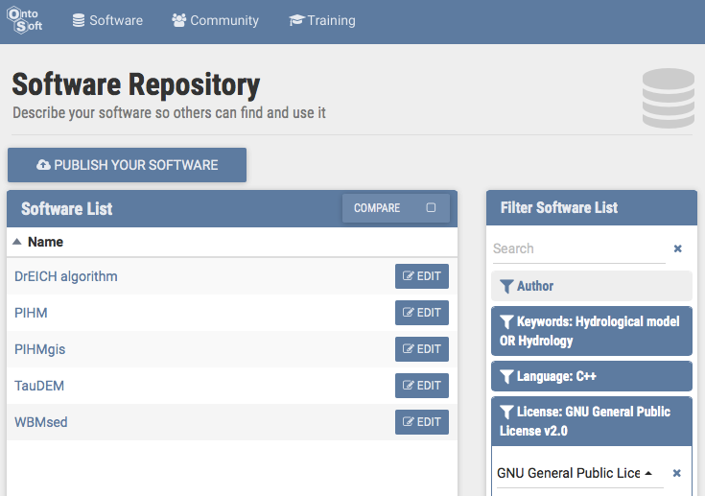
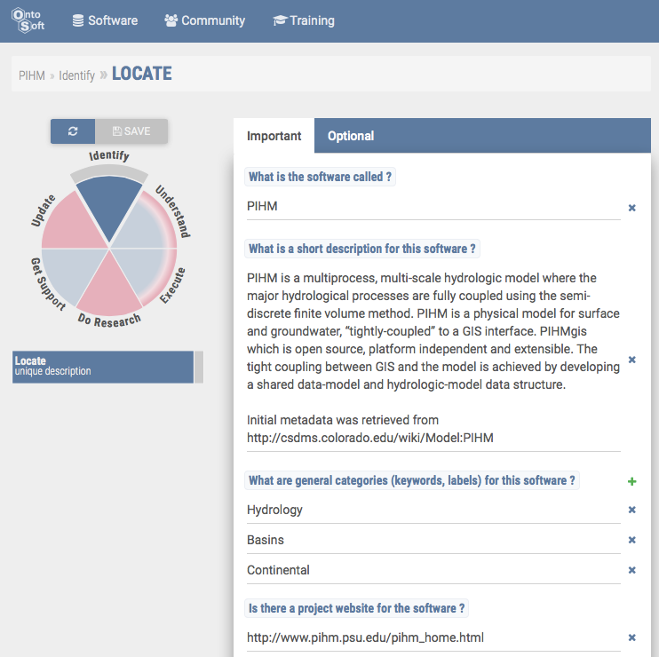
Prior Work: OntoSoft Software Metadata Registry
From Software Metadata Registries to Knowledge Graphs: OntoSoft and OKG-SOFT – SSRCW19
OntoSoft
Distributed Software Metadata Registry
Complements code repositories to make them understandable
Software metadata designed for scientists
Metadata is curated by decentralized communities of users
Training scientists on best practices
Finding Software
http://ontosoft.org
[Gil et al 2015]: OntoSoft: Capturing Scientific Software Metadata Eighth ACM International Conference on Knowledge Capture, Palisades, NY, 2015

Slide 4
Prior Work: OntoSoft Software Metadata Registry
From Software Metadata Registries to Knowledge Graphs: OntoSoft and OKG-SOFT – SSRCW19
Is this enough for Scientific Software reusability?

Slide 5
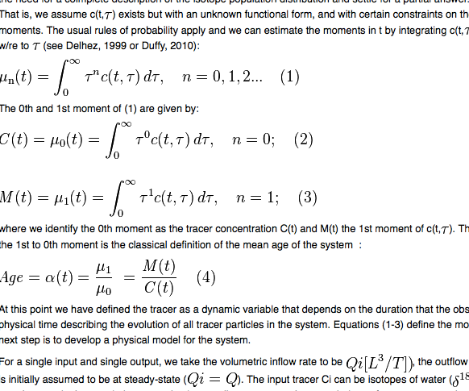
Requirements for Software Reusability
From Software Metadata Registries to Knowledge Graphs: OntoSoft and OKG-SOFT – SSRCW19
Exposing software inputs, outputs and their corresponding variables
Input1
Input2
Input3
Weather
DEM
Infiltration
Hydrology Software Model
- Land surface temperature (degC)
- Precipitation rate (mm/h)
- Land surface wind speed (m/day)
- Net radiation (MJ/(day m^2))
Outflow
Error
Output1
Output2

Slide 6
Requirements for Software Reusability
From Software Metadata Registries to Knowledge Graphs: OntoSoft and OKG-SOFT – SSRCW19
Exposing software inputs, outputs and their corresponding variables
Capturing the functions of the software component being used
Hydrology Software Model
Function A: Richards Equation for water movement (unsat soil)
Function B: Saint Venant equations (shallow water)

Slide 7

Requirements for Software Reusability
From Software Metadata Registries to Knowledge Graphs: OntoSoft and OKG-SOFT – SSRCW19
Exposing software inputs, outputs and their corresponding variables
Capturing the functions of the software component being used
Using principled ontologies with structured names for model variables, processes, and methods
svo:land_surface_ air__temperature
T_C
Temp
T

Slide 8


Requirements for Software Reusability
From Software Metadata Registries to Knowledge Graphs: OntoSoft and OKG-SOFT – SSRCW19
Exposing software inputs, outputs and their corresponding variables
Capturing the functions of the software component being used
Using principled ontologies with structured names for model variables, processes, and methods
Capture the semantic structure of software invocations
Dependencies?
Sample runs?
Invocation command?
Is data supposed to be in the same folder?
Default arguments/Configuration files?
Volumes?
Do I have to log in in the image

Slide 9
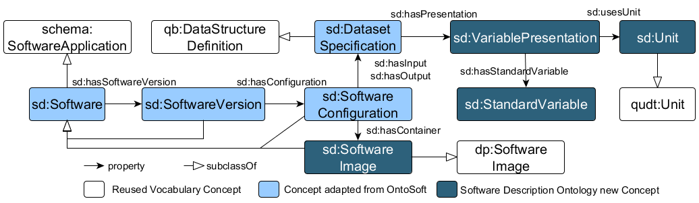
Evolving OntoSoft: Software Description Ontology
From Software Metadata Registries to Knowledge Graphs: OntoSoft and OKG-SOFT – SSRCW19
Extensions:
Schema.org (software metadata) + Codemeta
W3C Data Cubes (Contents of inputs and outputs)
NASA QUDT (Units)
DockerPedia (Software images)
Scientific Variables Ontology (Standard Variables)
https://w3id.org/okn/o/sd#

Slide 10



OKG-SOFT: Framework
From Software Metadata Registries to Knowledge Graphs: OntoSoft and OKG-SOFT – SSRCW19
Software Model Catalog contains:
Models from hydrology, agriculture and economy, their versions and model configurations.
More than 200 variables mapped to SVO.
All models are executable through scientific workflows
Most contents are added manually (expert users) collaboratively
Automated unit transformations
Automated software image description
Semi-automated Wikidata linking
APIs:
SPARQL endpoint
REST APIs (GET/POST)
Python clients
https://query.mint.isi.edu/api/mintproject/MINT-ModelCatalogQueries#/

Slide 11
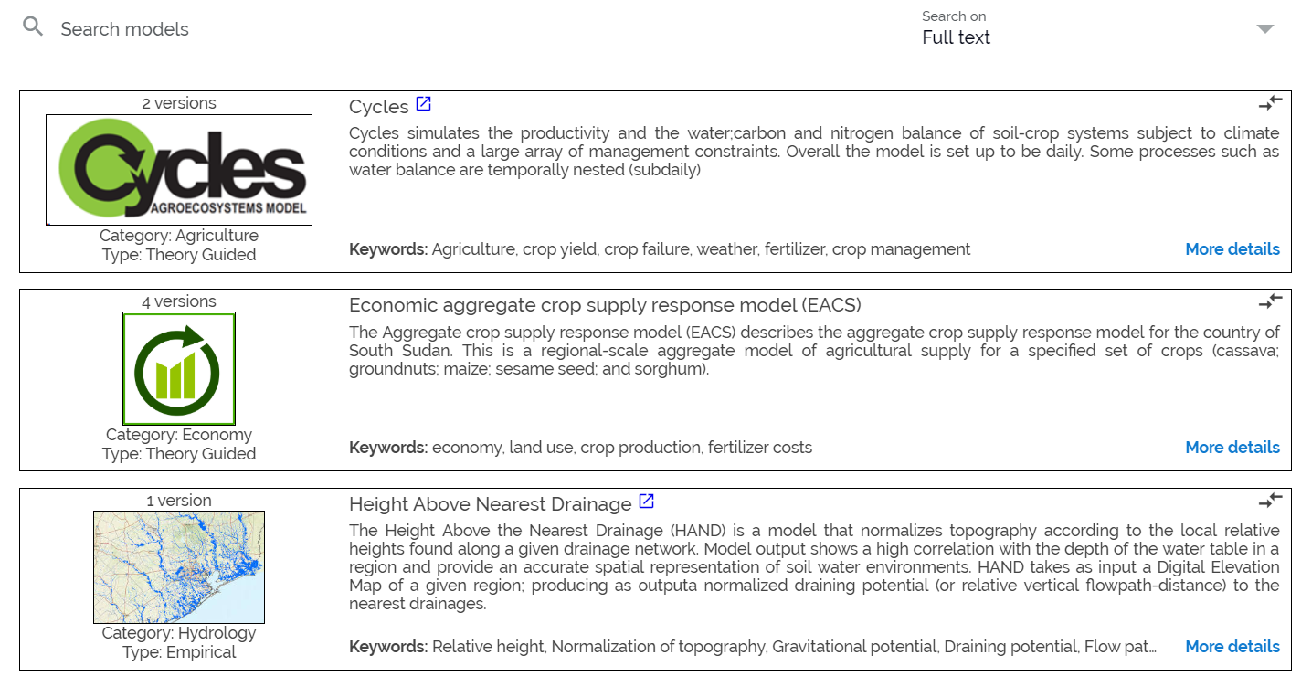
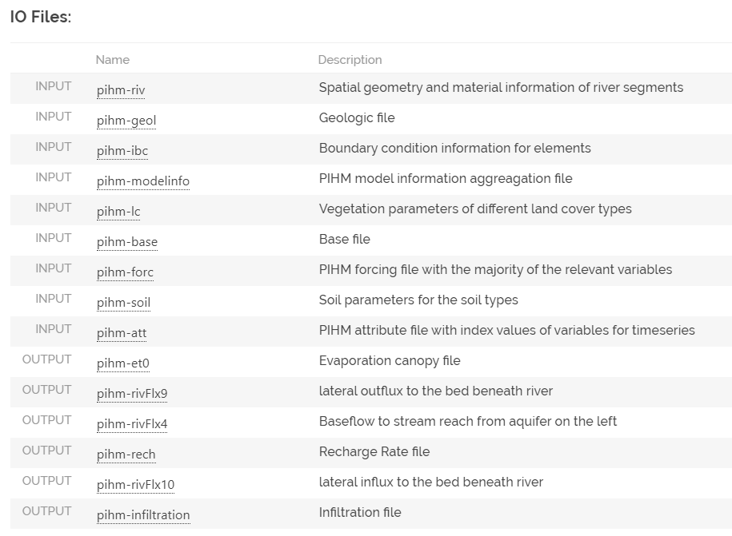
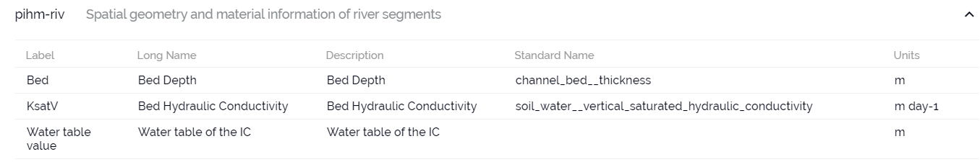
Exploitation: Exploring Scientific Software Model Metadata
From Software Metadata Registries to Knowledge Graphs: OntoSoft and OKG-SOFT – SSRCW19
Explore Software I/O
Find Software Models
Explore variables
Compare models
http://models.mint.isi.edu

Slide 12
Summary
From Software Metadata Registries to Knowledge Graphs: OntoSoft and OKG-SOFT – SSRCW19
Scientific Software is crucial to understand
Existing data
Published methods
Scientific Software Metadata registries help search and understand software
Enough for software reusability?
Requirements for scientific software reusability:
Describing inputs, outputs, variables and software invocation details
Our approach for capturing and structuring scientific software

